Slide 1

Welcome to KS1
Meet and Greet

Slide 2

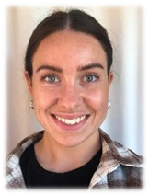
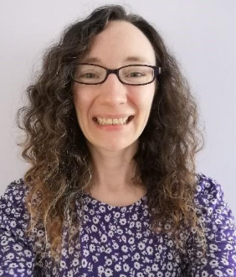
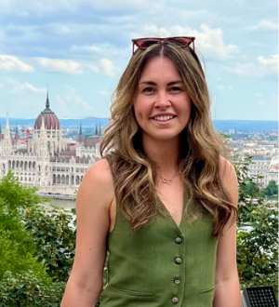
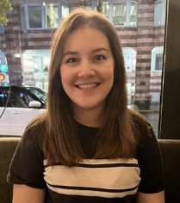
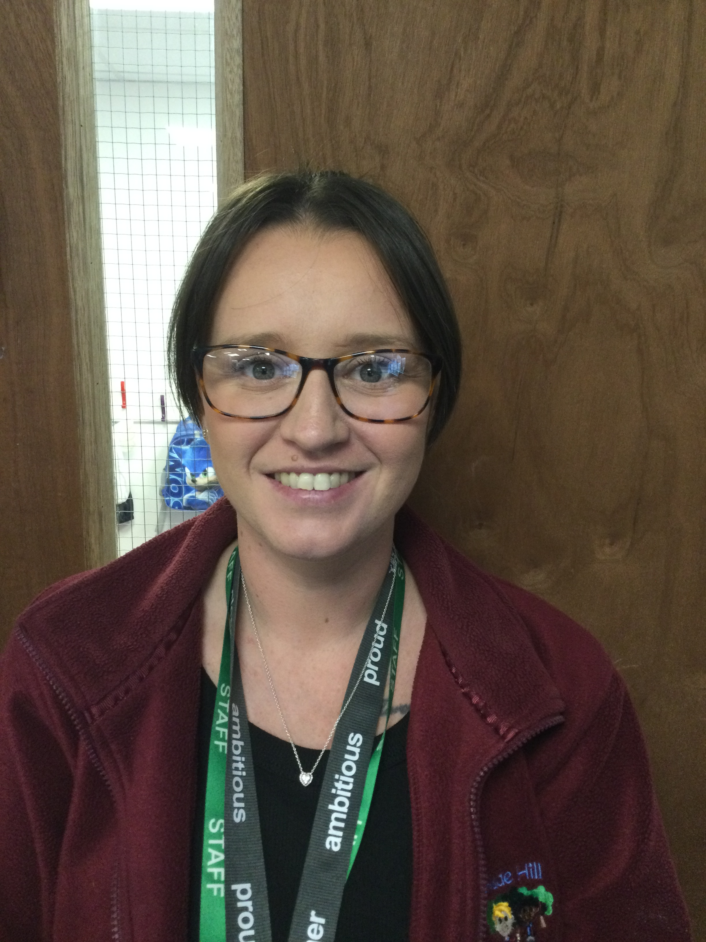
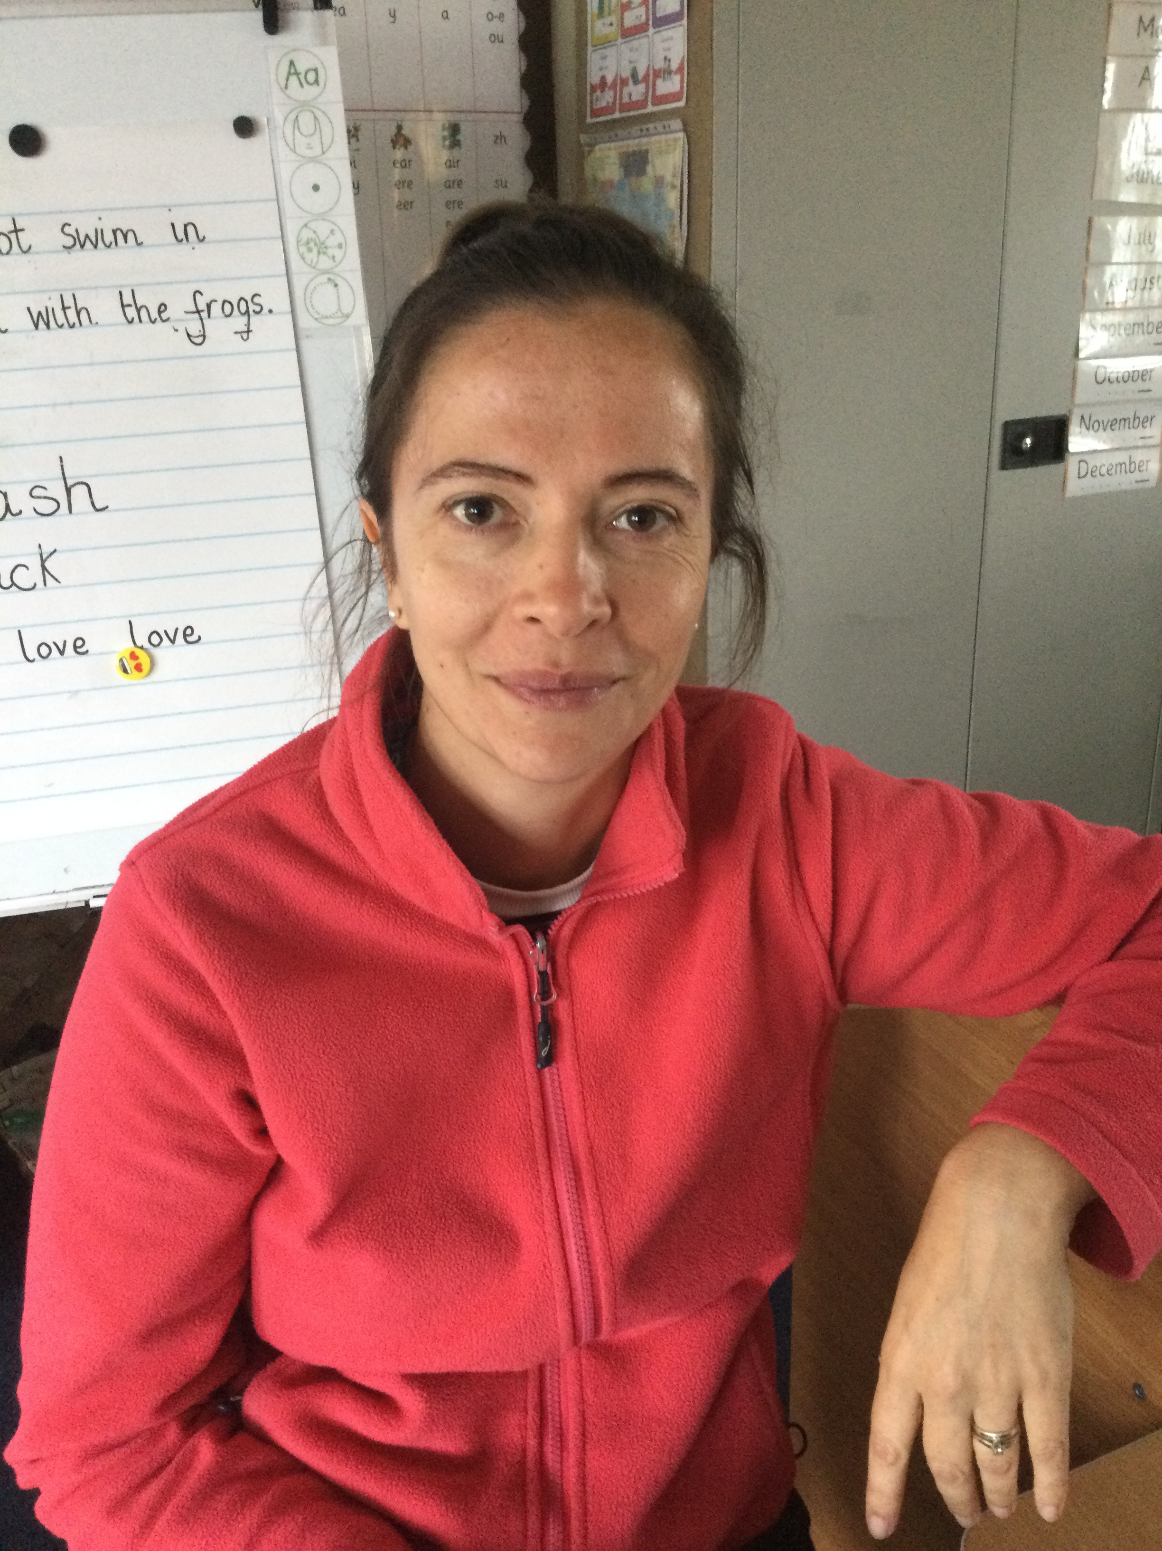
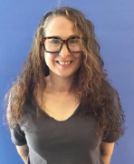
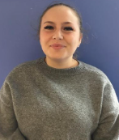
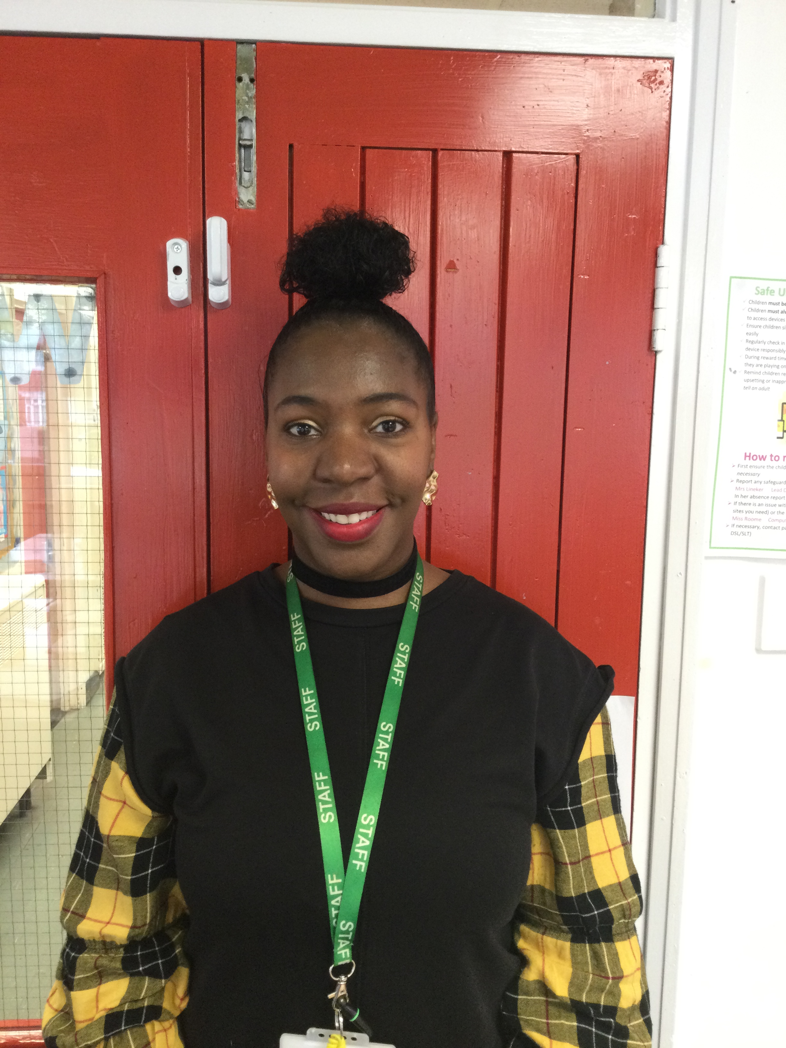
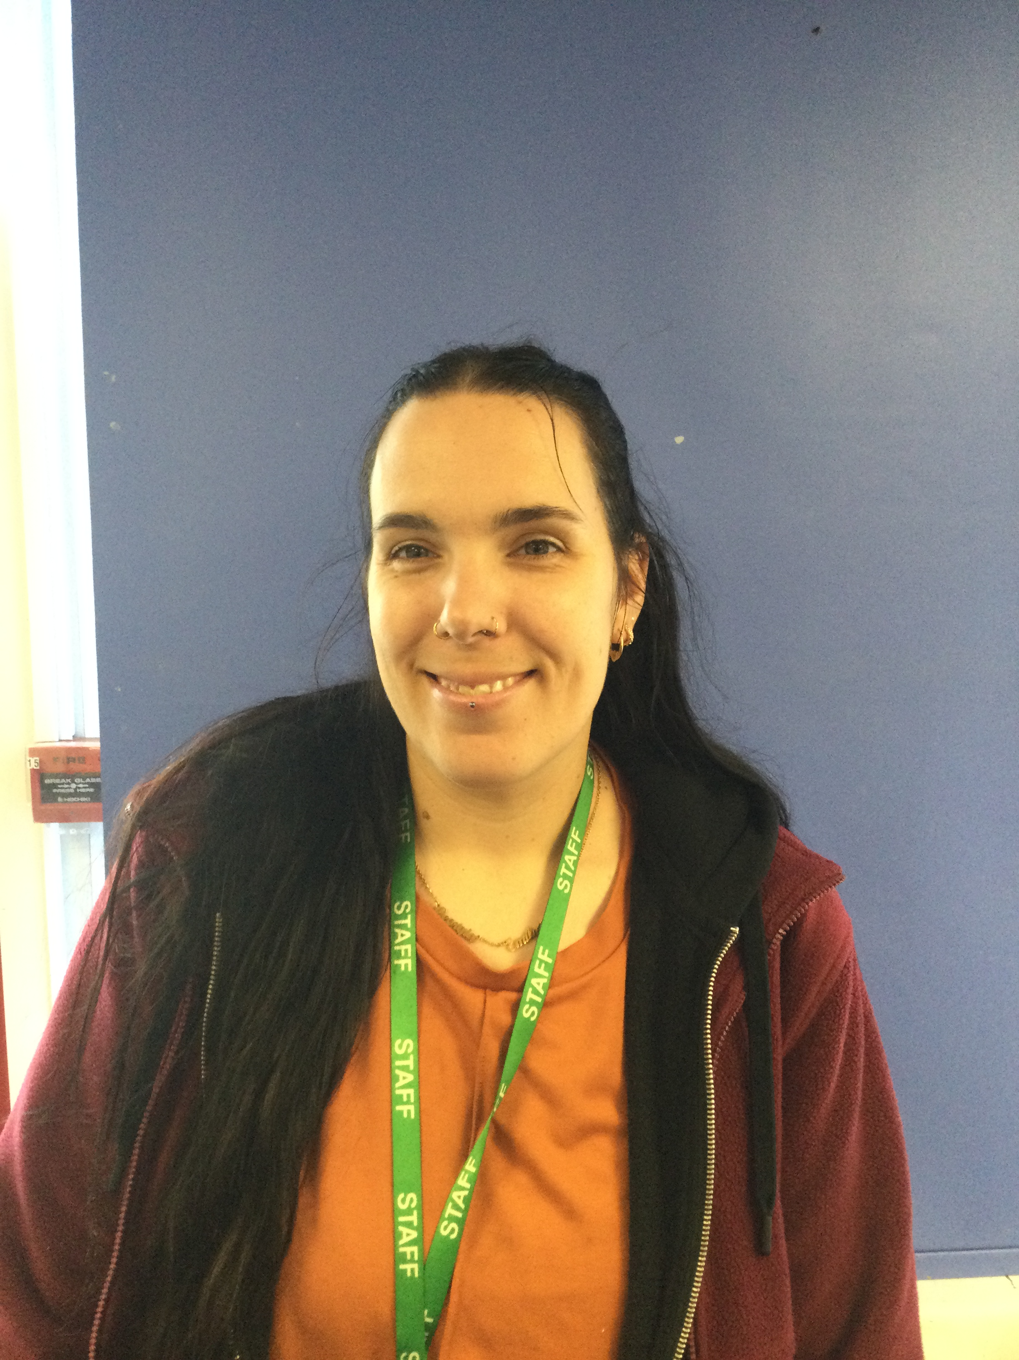
Who’s who?
Miss Heffernan
KS1 Phase Leader and Early Reading Leader
Year 1 Beeches Teacher
Mrs Potter
Year 1 Bonsais Teacher
Science Leader
Miss Cribb
Year 2 Wisterias Teacher
Geography Leader
Miss Tombs
Year 2 Wisterias Teacher
History Leader
Mrs Beckett and Miss Wyer
Year 1 Beeches Teacher Assistants
Miss Hunt and Miss Phillips
Year 1 Bonsai Teacher Assistants
Miss Bowmar and Mrs Ramage
Year 2 Wisterias Teaching Assistant
Mrs Speed
Year 2 Willows Teaching Assistant

Slide 3


Our School Website

Slide 4
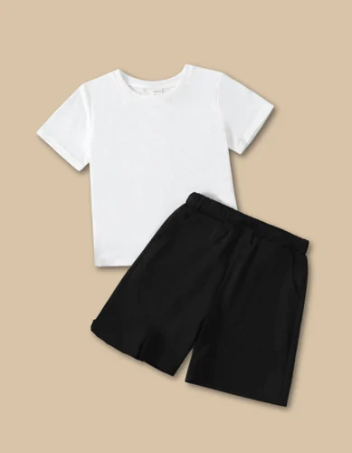

PE days and Expectations
KS1 PE days are Tuesday, Thursday and Friday
Send your child to school with a PE kit in a separate PE bag.
Keep it in school during each half term.
No jewellery please.

Slide 5

Reading at home
Please read at home with your child at least 3x a week and record this in their reading diary. We recommend you read your child’s school reading book but reading for pleasure books are also welcome.
  This will go towards your child’s reading award:
  40 reads = Prize
  80 reads = Prize
  120 reads = Prize and even a trip out of school!!
For more support on this please speak to your class teacher or Miss Heffernan

Slide 6
Our Communication System
  MarvellousMe will be changing its name to Juniper – Please look out for updates on this.

Slide 7

Phonics Screening check
This will be taken by all children in Year 1 in the Summer term. It is a way for teachers to ensure that children are making sufficient progress with their phonics skills to read words and that they are on track to become fluent readers.
The children will have lots of practice throughout the year and it helps us to make sure they receive any additional support they may need.
They will be checked on 20 real words and 20 pseudo words (made up words) to ensure they are able to decode words using their phonics skills.
If they do not meet the standard in Year 1, they will retake this in Year 2 with the additional support they need.

Slide 8



Homework Expectations
  Your child will be given a username and password for MyMaths and Purple Mash. These can be found at the back of your child’s reading diary. Your child’s class teacher will set weekly task to be completed.
  If you have trouble logging onto a device at home, your teacher will give you a paper version if necessary.
  You child will be given a sheet with graphemes they have been taught that week, alongside words and sentences to practice. The children will be tested on these the following week so please practice these at home.

Slide 9
School Meals
All children in Year 1 and 2 automatically receive a free school meal.
We encourage that you use this opportunity for children to try new foods. There are always 2 choices alongside a vegetarian option.
It works on a 3 weekly cycle and you can find out dinner menu on our school website or feel free to ask your child’s class teacher.

Slide 10
Attendance and Lateness
The school gate opens at 8.30 until 8.45 – Please ensure you are arriving on time so they children get the most out of their day. Routines are vital for young children.
It is important that you bring your child to school every day.

Slide 11
Fidget Toys
Please keep all toys at home. If your child requires a fidget toy at school to support their concentration it will be provided by the class teacher or SENco.
If you have any worries regarding this, please speak to your class teacher

Slide 12
Key Dates
Year 1
Monday 22nd September – 8.45am - Excite and Engage
Friday 10th October – 2.30pm - Stay and Learn
Year 2
Thursday 2nd October - 2.30pm = Stay and Learn

Slide 13

Questions

