Slide 1

Welcome to Year 1 & 2
Meet and Greet

Slide 2
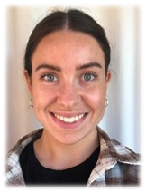
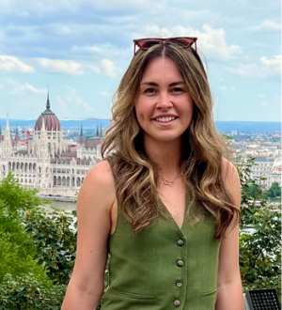
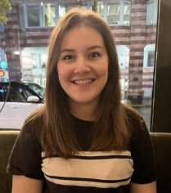
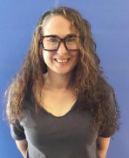
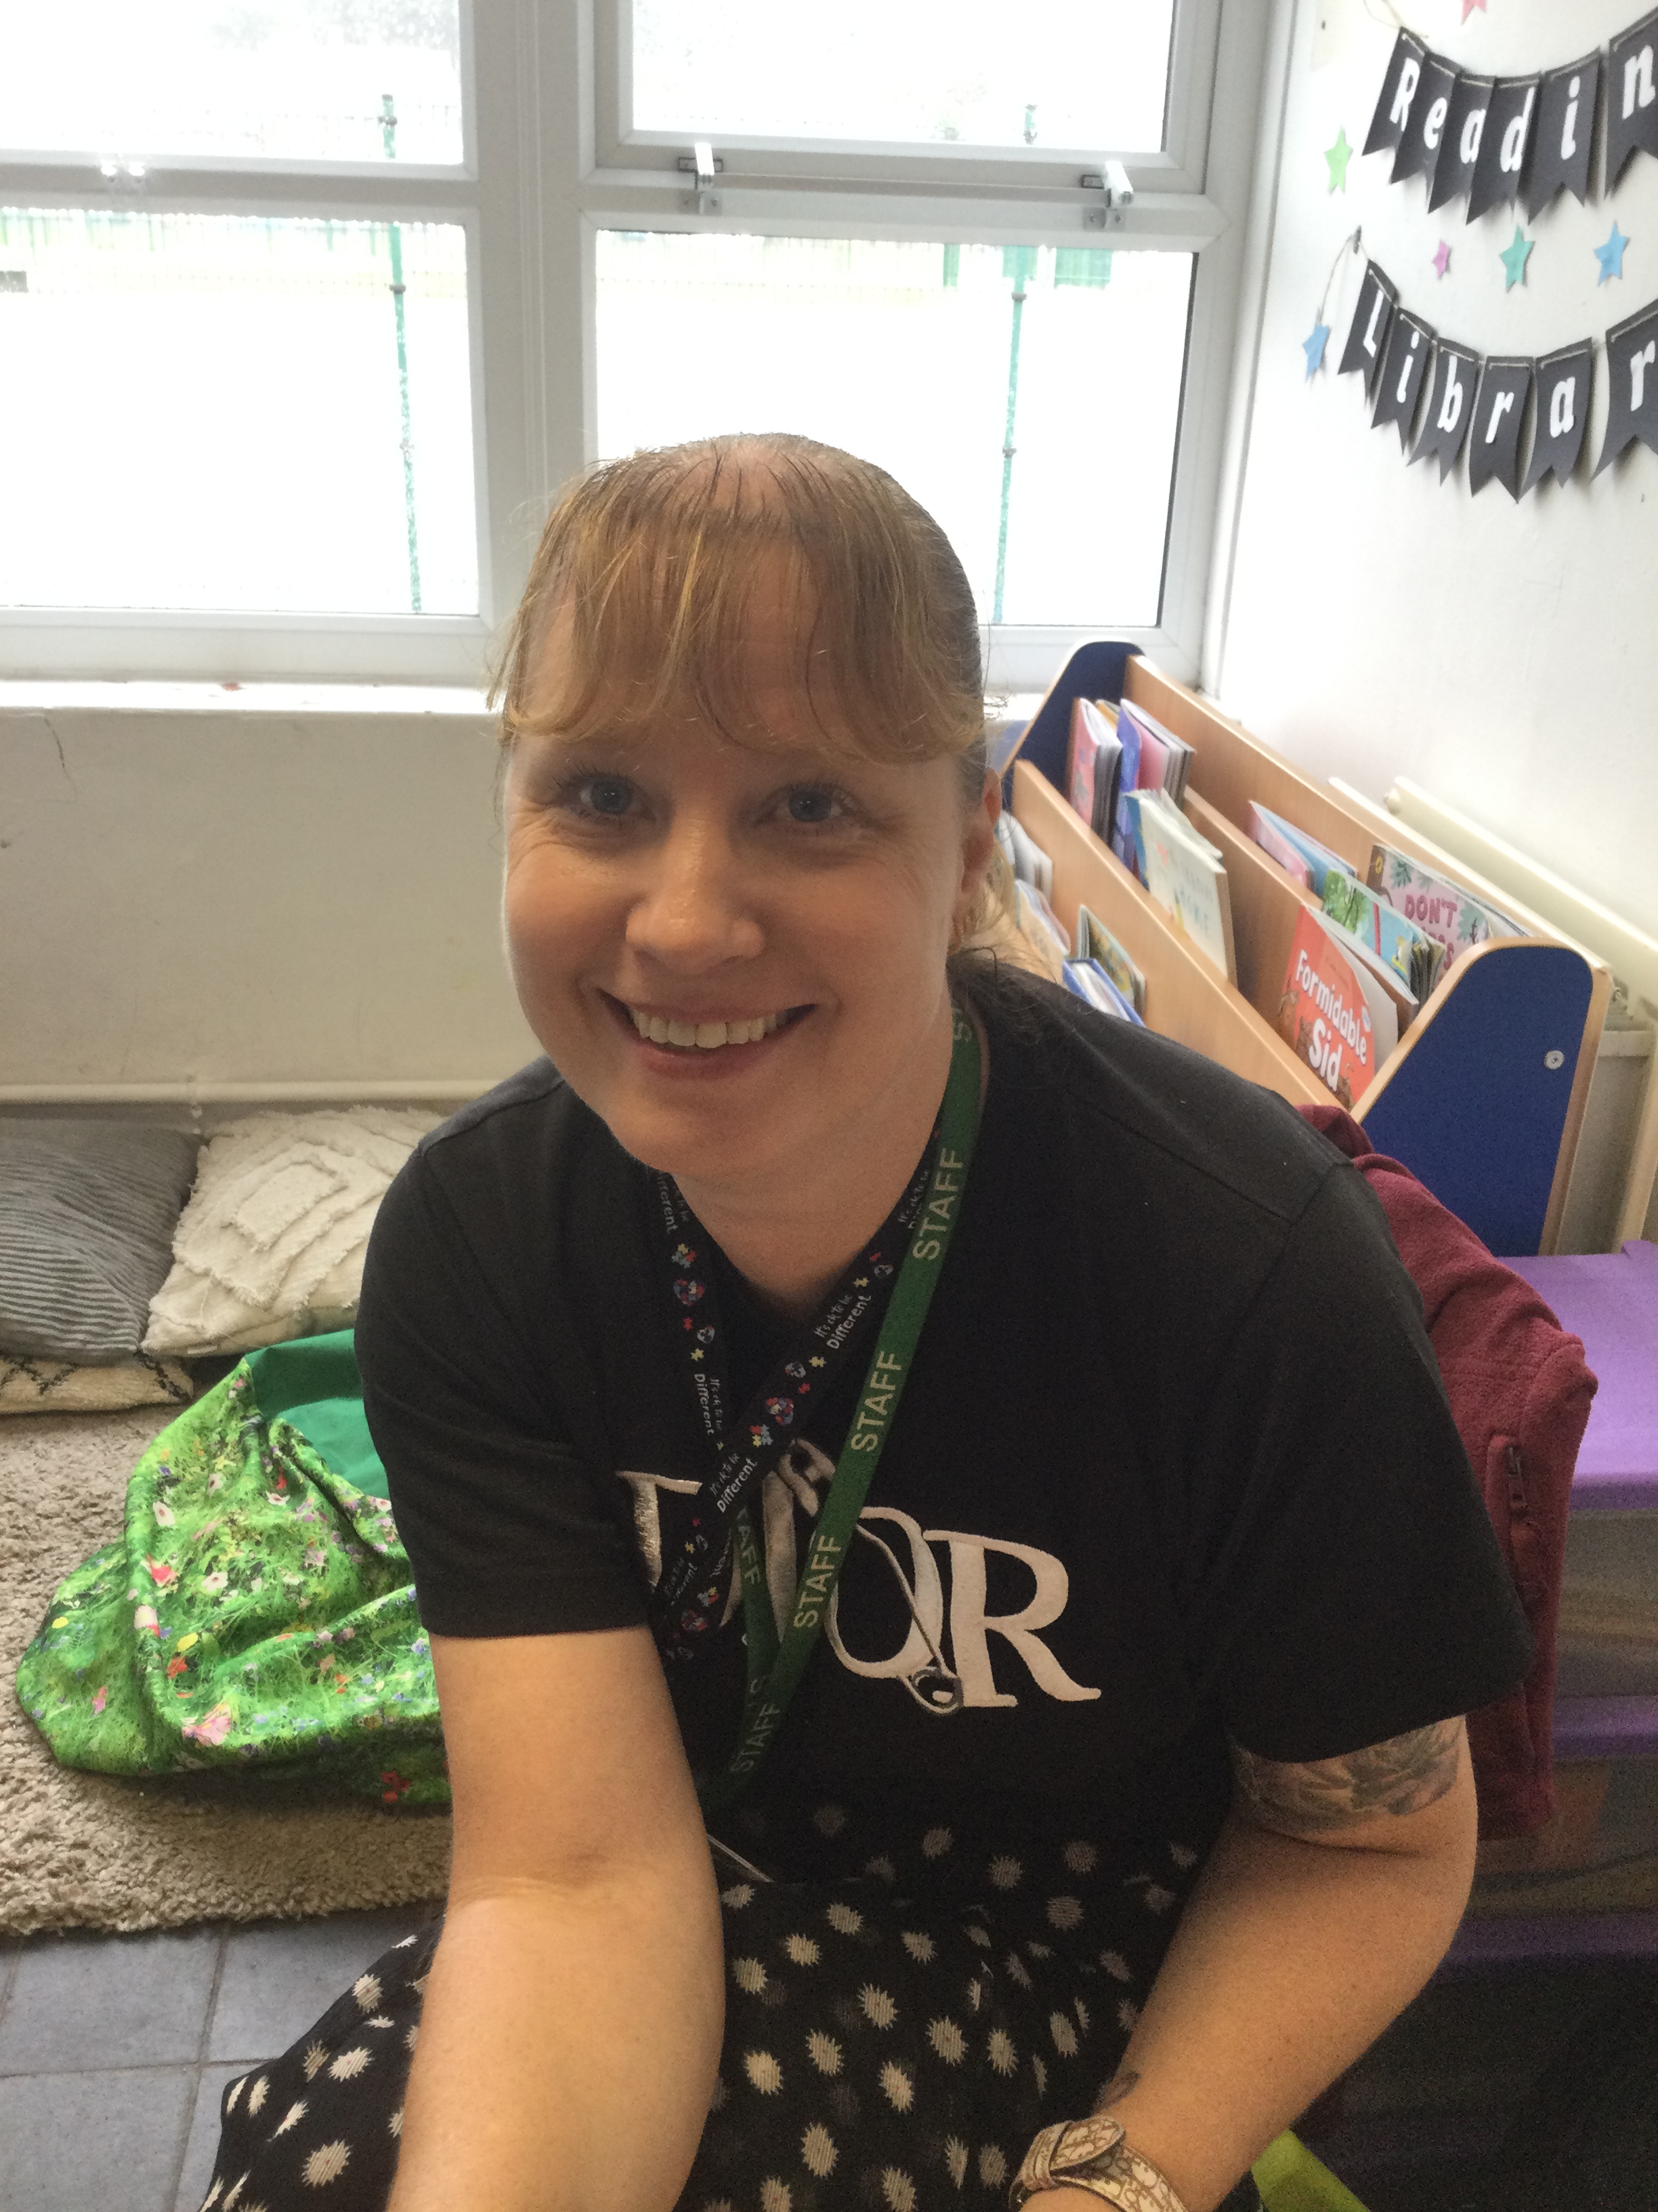
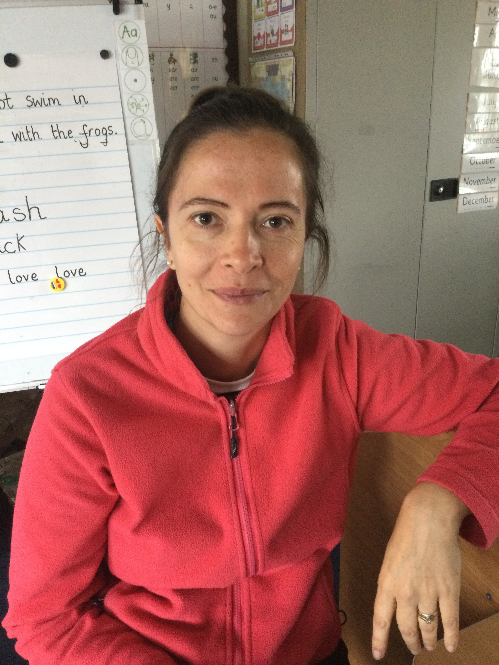
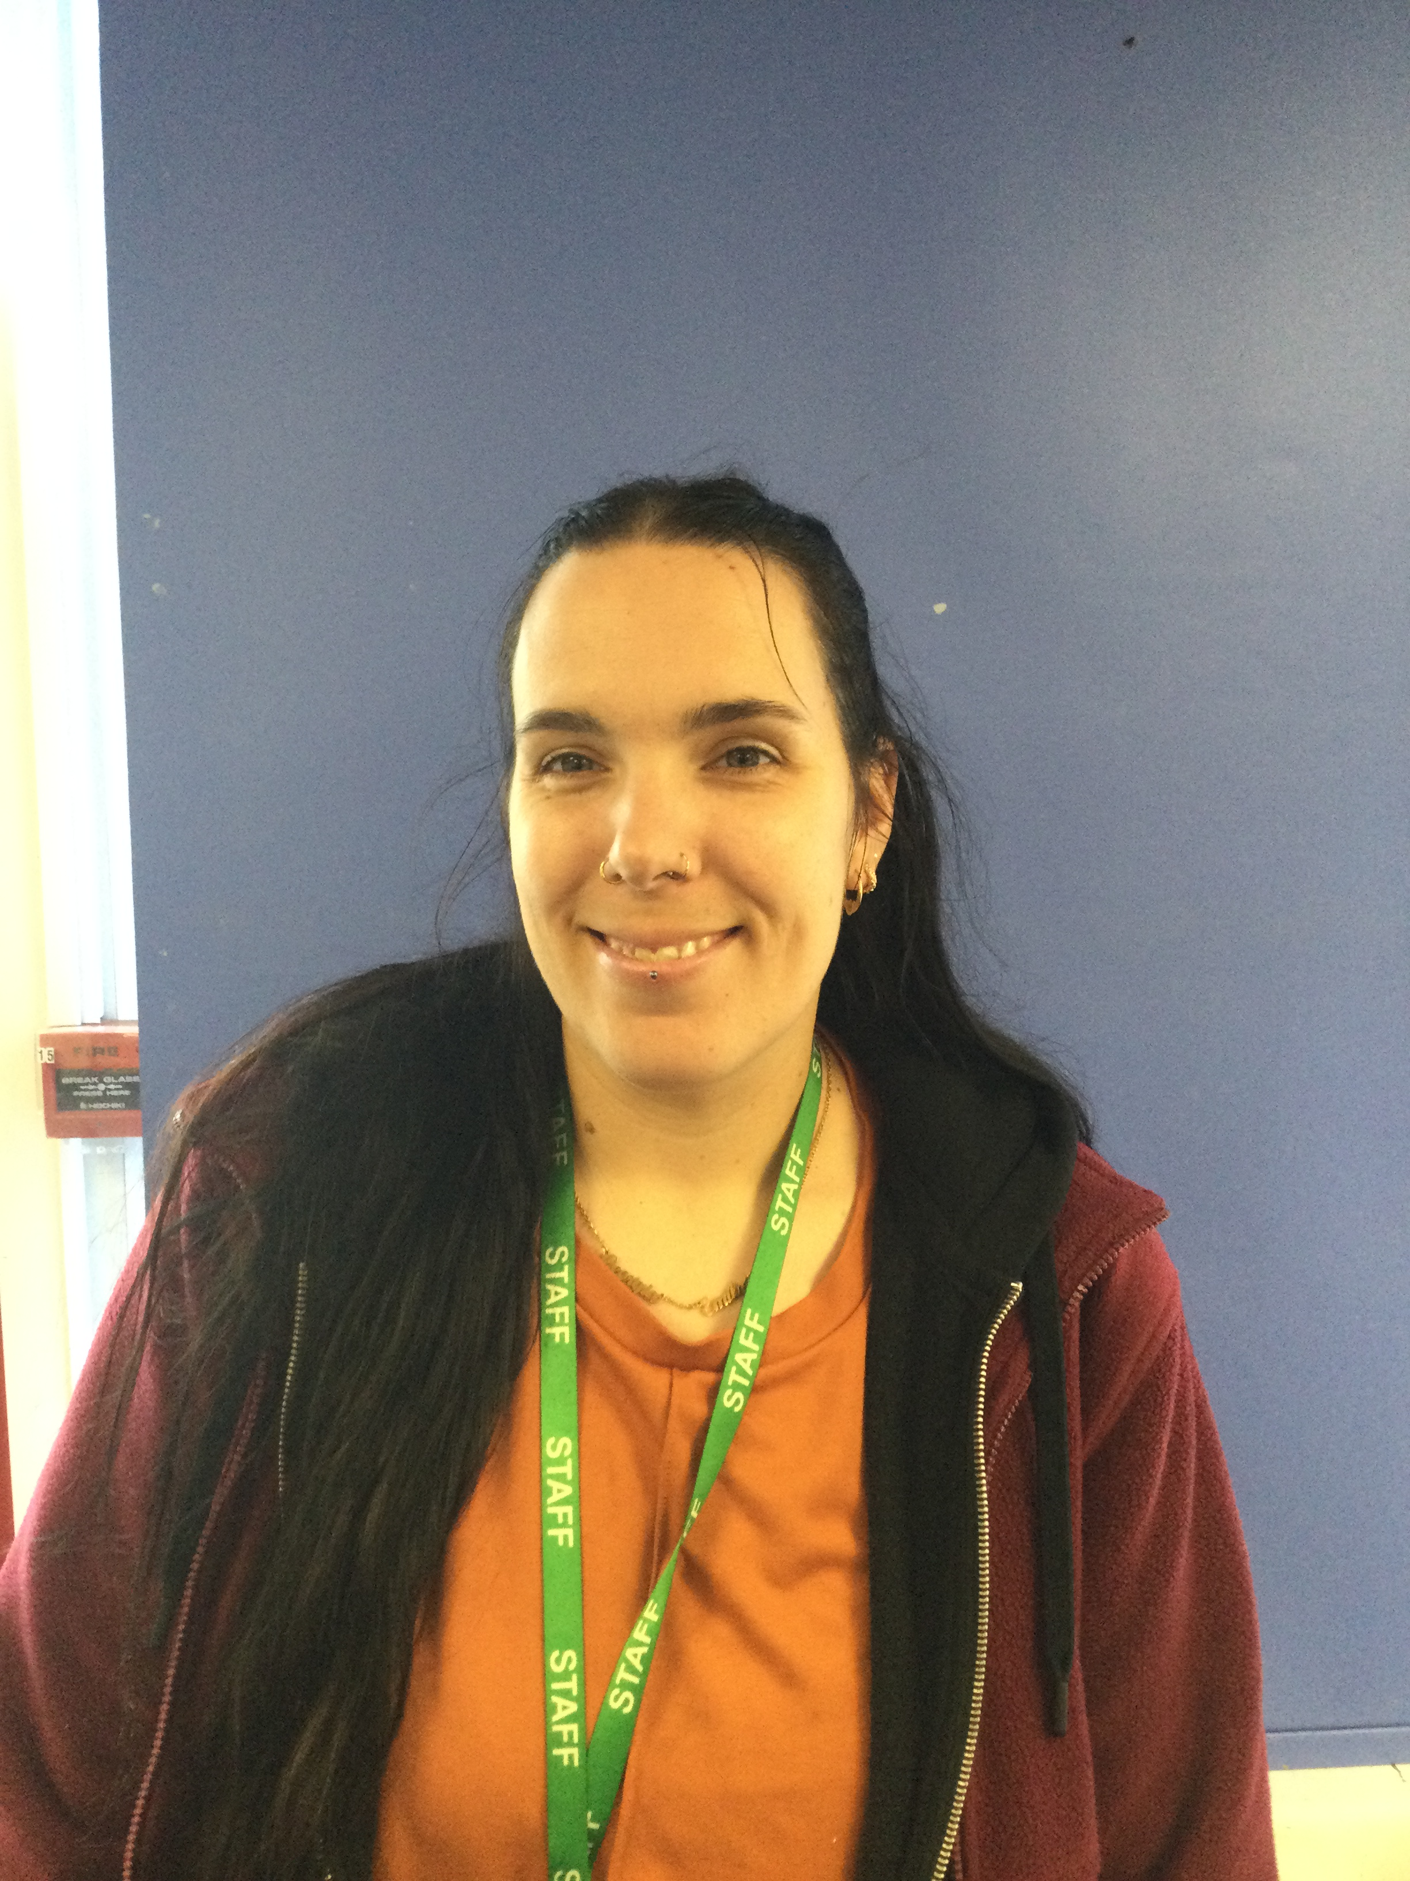
Who’s who?
Miss Heffernan
Year 1 Beeches Teacher
KS1 Phase Leader and Early Reading Leader
Miss Cribb
Year 2 Wisterias Teacher
Geography Leader
Miss Tombs
Year 2 Wisterias Teacher
History Leader
Mrs Beckett and Miss Bowmar
Year 1 Beeches Teacher Assistants
Miss Hunt
Year 2 Wisterias Teaching Assistant
Miss Ramage
Year 2 Willows Teaching Assistant

Slide 3

Methods of Communications
We no longer use the juniper App and will contact you through the Arbor app or our class email.
Download the Arbor app to receive updates and information about your child – please ensure your childs information is up to date
‘
A class teacher on the gate at the beginning of each day.
Letters
Website
Class email
Class emails
beeches@gladehill.nottingham.sch.uk
wisterias@gladehill.nottingham.sch.uk
willows@gladehill.nottingham.sch.uk

Slide 4


Our School Website

Slide 5
Drop-Of Information
All children can attend the Free Breakfast Club which starts at 8.00am. Gates are locked at 8.15am so please arrive before then. We still offer a paid breakfast club which starts at 7.45am
If not attending breakfast club, children need to arrive at school at the classroom doors at 8.30am. This is when school now officially starts.
Gates will be locked soon after so if you are late you will need to take your child to the office. We aim to have all gates locked by 8.40am.
Please make sure your children arrive at school on time as learning starts straight away and we don’t want them to miss out on valuable learning time.

Slide 6
Pick Up Information
All children will finish school at 3.00pm.
We do offer a paid after school club if you need a later pick up.
Children will be taken to the office if they are not picked up by 3.15pm. If you are regularly late to pick up your child they will be taken to the after school club and you may be charged. The after school provision is in the Nook.
If you have made arrangements for someone else to pick up your child, please let the office know beforehand and pass on their contact information.

Slide 7
Attendance
Improving school attendance is a top priority. Every day counts.
Missed time off school is a missed opportunity to learn.
We have lots of incentives to celebrate excellent attendance that will continue this year, including class trophies and attendance badges/ medals. We will be sharing more about this soon.
How to report absences:
Phone the office or leave a message on the school answer machine
Send an in app message on Arbor
We have a duty of care to all children so we may call you to check how your child is

Slide 8


Slide 9
Our School Ethos
S
P
A
R
K
L
E
Self-motivated
Polite
Ambitious
Resilient
Kind and Caring
Learners
Enthusiastic
Golden Rules:
Care for everyone and everything
Show good manners at all times
Follow instructions straight away
We love to celebrate the children’s successes and we praise children for how they SPARKLE!

Slide 10
Behaviour at Glade Hill
Rewards
Each class has their own learning ladder
Celebration certificates
Class and headteacher prizes
Stickers
Messages home
Consequences
Level 1 behaviours and consequences will be managed in school. You will be informed if behaviours continue after consequences
Level 2 Behaviours and Consequences – Parents will be informed by class teachers
Level 3 Behaviours and Consequences – Parents will be informed by Senior teachers or leaders

Slide 11
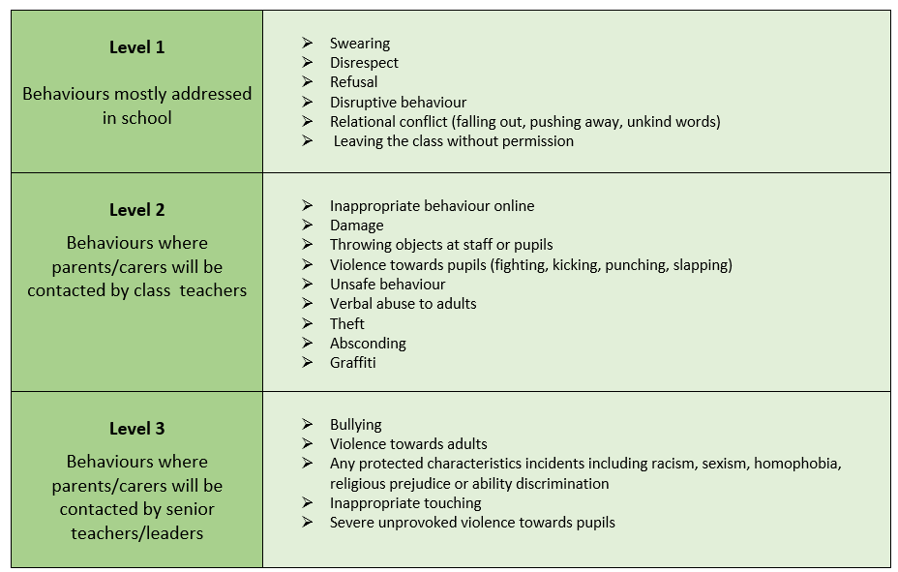

Slide 12
Curriculum and Learning
Learning across all subjects is organised into 3 stages:
Excite and Engage
Learn and Connect
Communicate and Remember
The class pages and half termly newsletters have more detailed information on each year group curriculum

Slide 13
Uniform
We expect all children to in school uniform from the start of term. This includes appropriate footwear. Please take a look at our school website for full details on our uniform policy.
PE days – Children can come to school in their PE kits.
Year 1 – Wednesday Year 2 – Monday
Jewellery and makeup is not allowed in school. Please ensure your child has removed these before arriving at school. This includes lip gloss and lip stick.
Stud earring are an exception and show be removed for PE days or covered up with tape by a parent/carer before the school day starts.
We have pre-loved uniform available – please contact the school office.

Slide 14
School Dinners
All children in Year 1 and 2 receive a free school meal.
We encourage that you use this opportunity for children to try new foods. There are always 2 choices alongside a vegetarian option.
New menus are available on the school website or from the school office.
Packed lunch – Reminder we are a NUT FREE school

Slide 15
Snack
School provide fresh fruit and vegetable for children each day.
If your child would like milk, you will need to pay for this through the ‘coolmilk’ website.
Please do not send your child to school with a snack other than fruit, if they do not wish to have the fruit provided at school.
Please send your child to school with a water bottle each day.

Slide 16
Fidgets
Fidgets and toys from home are not permitted at school.
If you feel your child requires a fidget, I needs to be authorised by Mrs Stapleton and provided by school.
Any queries around this, please speak to your class teacher.

Slide 17

Reading at home
Read at least 3x a week, at home, with your child.
Record it in their reading diary by signing your name and the date.
  This goes towards your child’s reading award:
  40 reads = Prize
  80 reads = Prize
  120 reads =Trip out of school!
For more support on this please speak to your class teacher

Slide 18

Phonics Screening check
Formal assessment taken by all Year 1 children in the Summer term.
They will be checked on 20 real words and 20 pseudo words (made up words) to ensure they are able to decode words using their phonics skills.
If they do not meet the standard in Year 1, they will retake this in Year 2 with the additional support they need.
Word cards may come home with your child, please practice these as much as possible. They can even count as a read.

Slide 19



Homework Expectations
  Your child will be given a username and password for MyMaths and Purple Mash. These can be found at the back of your child’s reading diary. Your child’s class teacher will set weekly task to be completed.
  If you have trouble logging onto a device at home, your teacher will give you a paper version if necessary.
  You child will be given a sheet with graphemes they have been taught that week, alongside words and sentences to practice. The children will be tested on these the following week so please practice these at home.

Slide 20
SPECIAL EVENT
On Friday 25th September we are having a very special event in school and it is going to be amazing!
The day will be a great experience before the other event starts at the weekend and also for those families who choose not to go it will make the perfect alternative for the children to enjoy with their friends – All for FREE!
We don’t want to spoil too many surprises just yet but it will include a non-uniform day with a special lunch and lots of great activities. Your children can come in their favourite clothes, partywear, dress-up or fair themed outfit!
We are so excited we can’t wait!

Slide 21

Birthdays- Let’s make your day even more special!
School day birthdays - On the day
Weekend Birthdays – The Friday before
Holiday Birthdays – The last Friday of the half term
If you’ve had your birthday already since 1st September – This Friday

Slide 22
Key Dates
Year 1
Thursday 15th October – Stay and Learn 8.30am
Year 2
Tuesday 6th October – Stay and Learn 8.30am
ALL
Monday 12th and Tuesday 13Th October – Parents evening
Tuesday 8th December – SNOW DOME
Friday 11th December – Christmas Performance

Slide 23

Questions

